Slide 1

Part 3: Part 3: System Integration and Cloud Communication

Slide 2
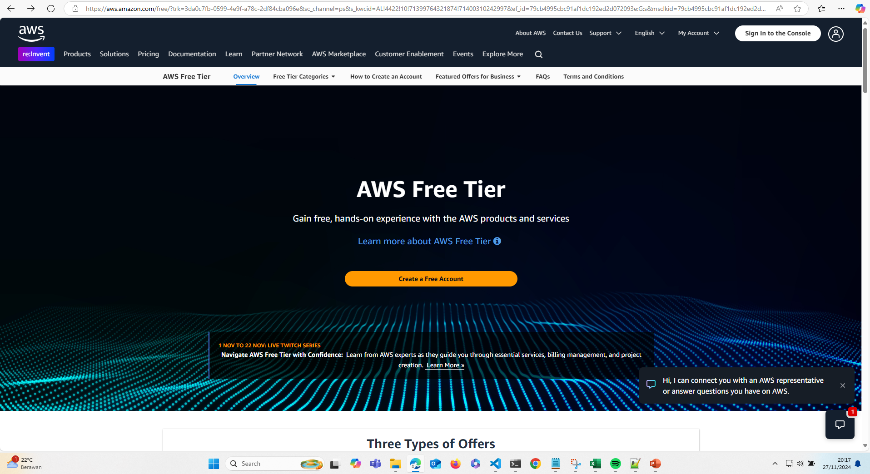
Register AWS S3 and choose Free Tier

Slide 3
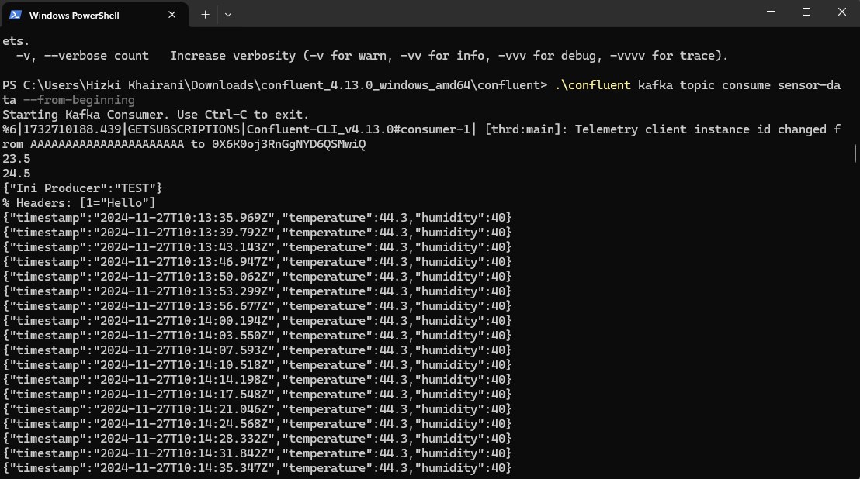
Consume Kafka topic from Confluent CLI

Slide 4
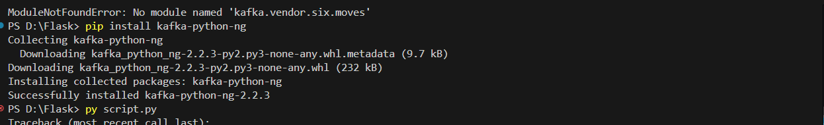
Install Dependency Kafka Python $ pip install kafka-python-ng and boto3 for (aws s3)

Slide 5
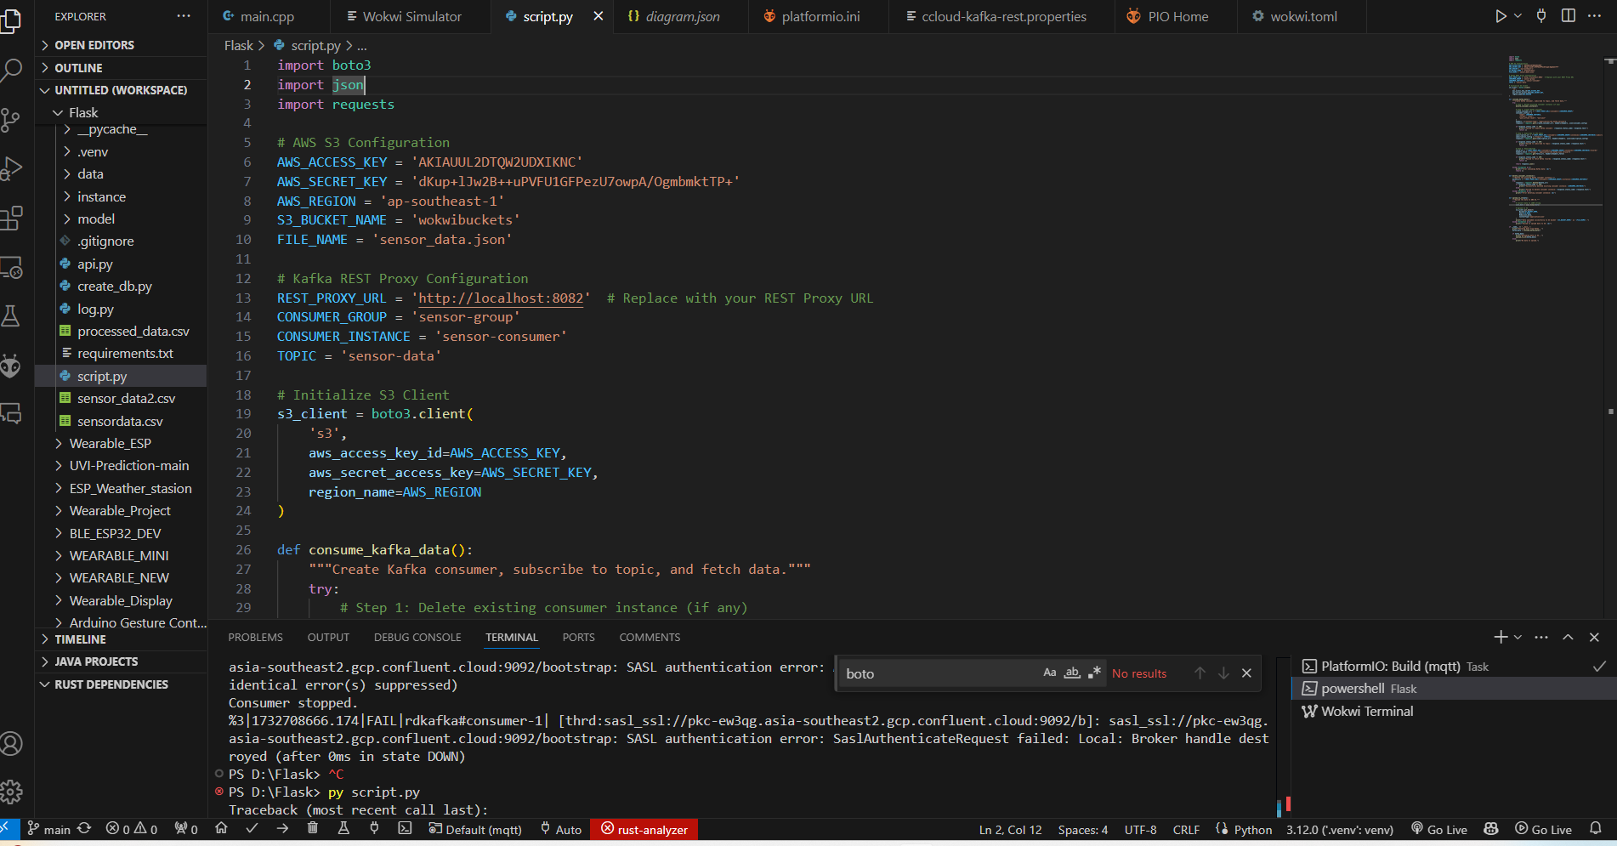
Create Script to send kafka, change AWS S3 Config and Kafka Rest based on your own configuration

Slide 6
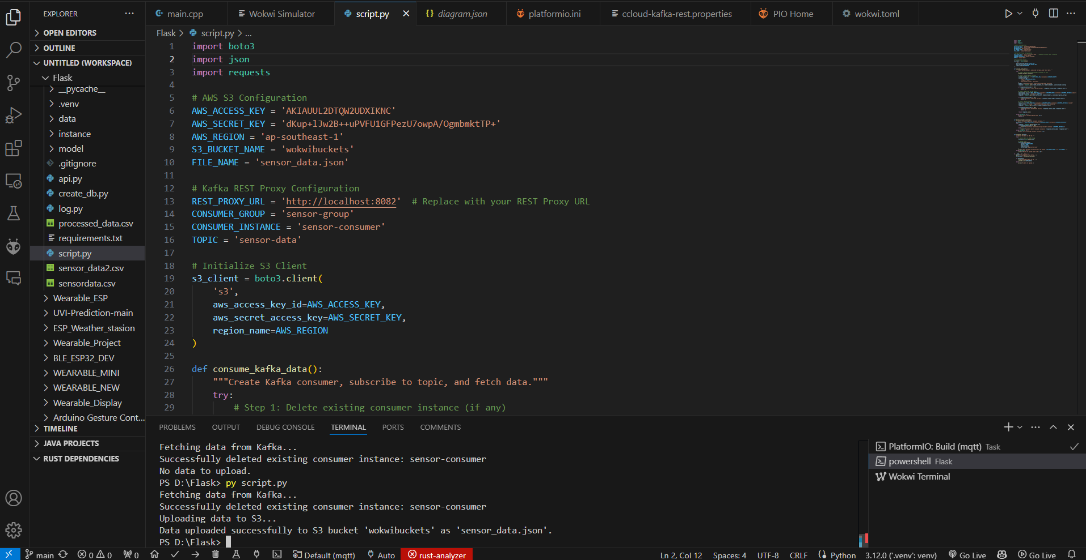
Running the script, I was facing issues due to duplicate consumer instance. But the data successfully sended to the AWS S3

Slide 7
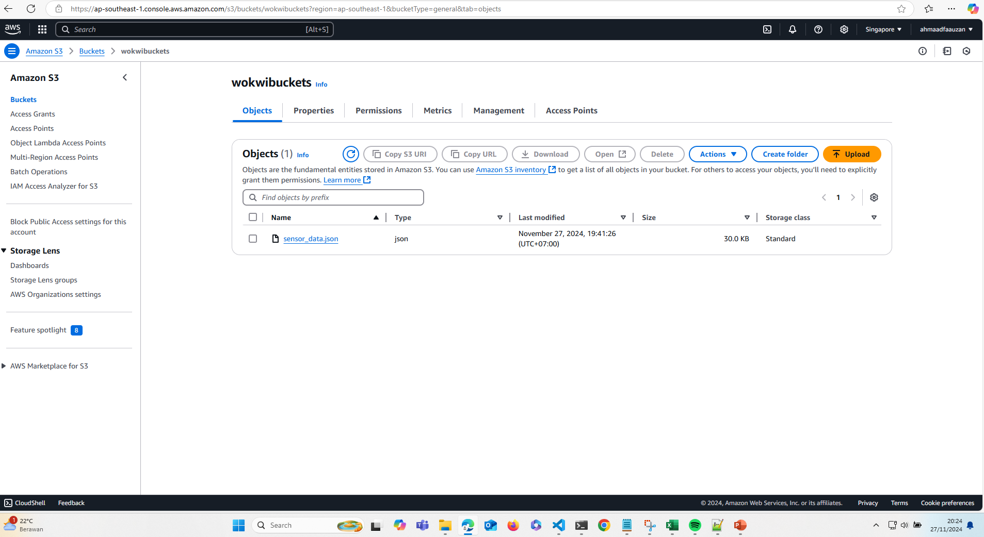
Data Output from kafka and node-red

Slide 8
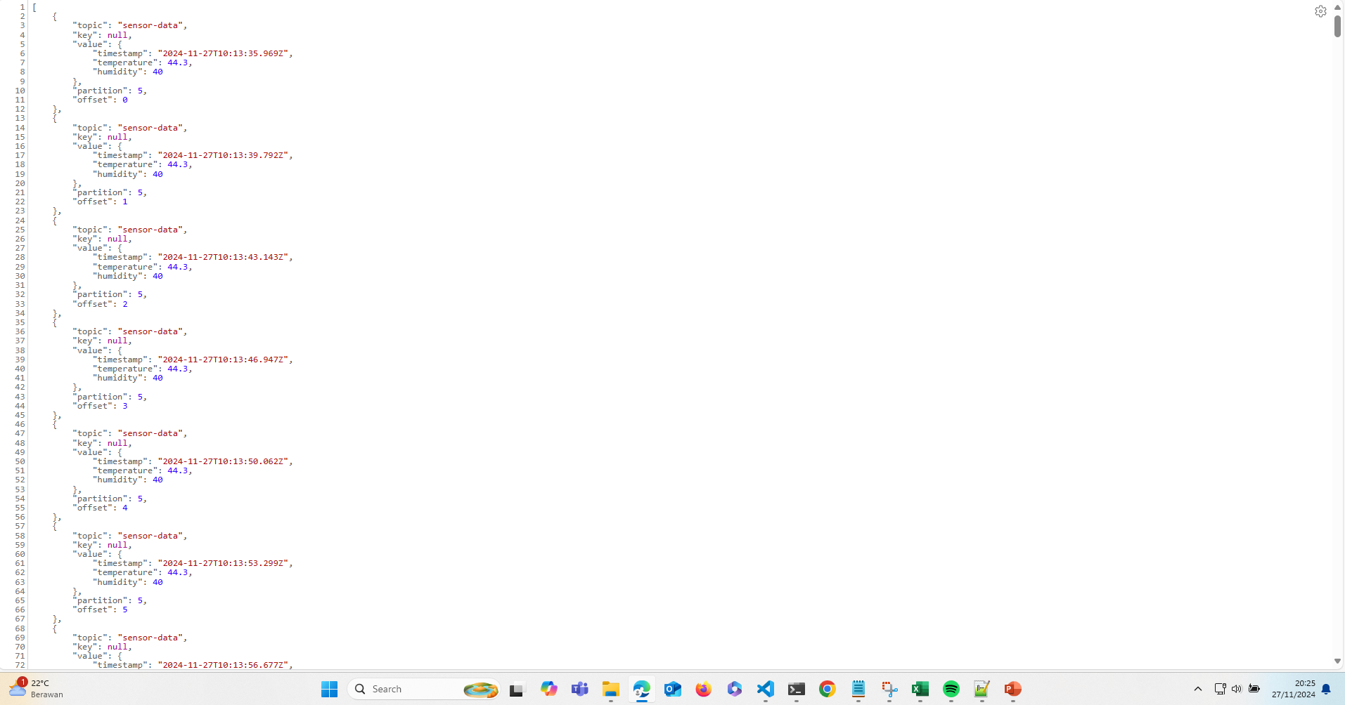
Json Output data from kafka

Slide 9
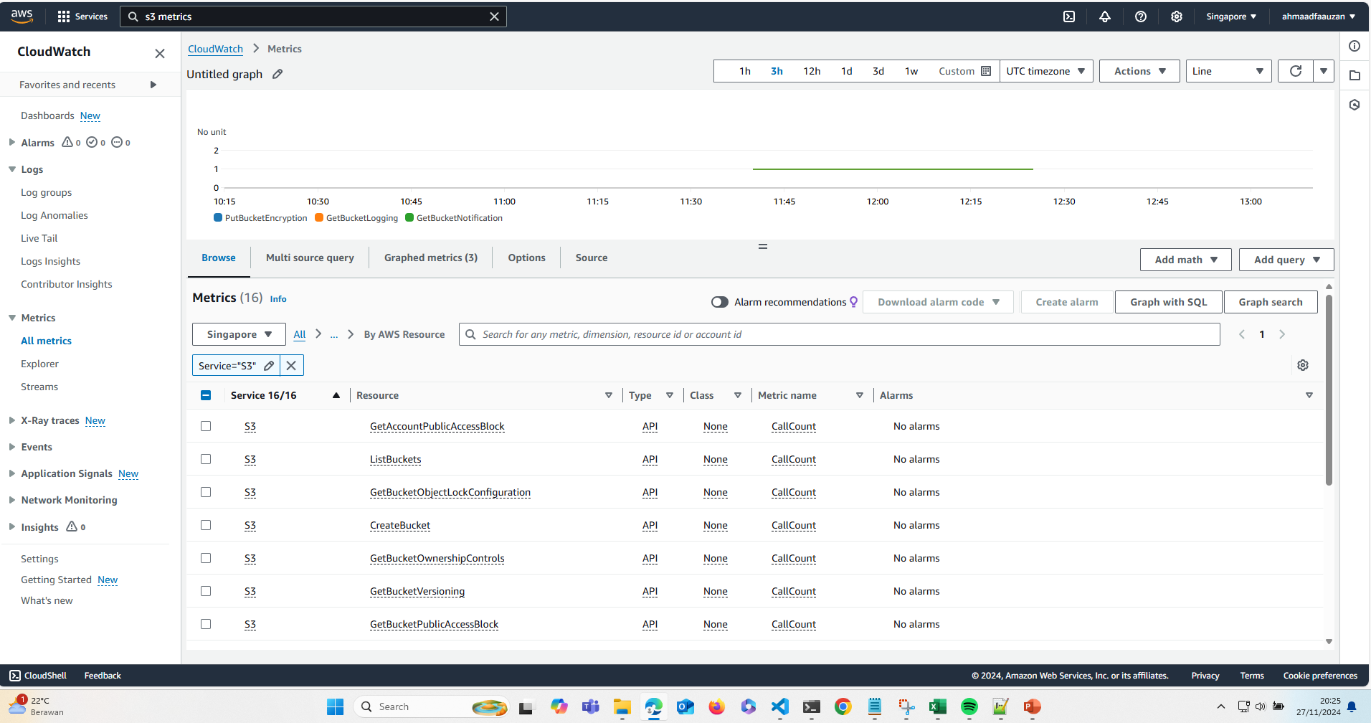
For monitoring and security we could use CloudWatch and some 3 services(PutBucketEncryption,GetBucketLoggin,GetBucketNotification)

Slide 10

Thank you
Brita Tamm
502-555-0152
brita@firstupconsultants.com
www.firstupconsultants.com

